Slide 1



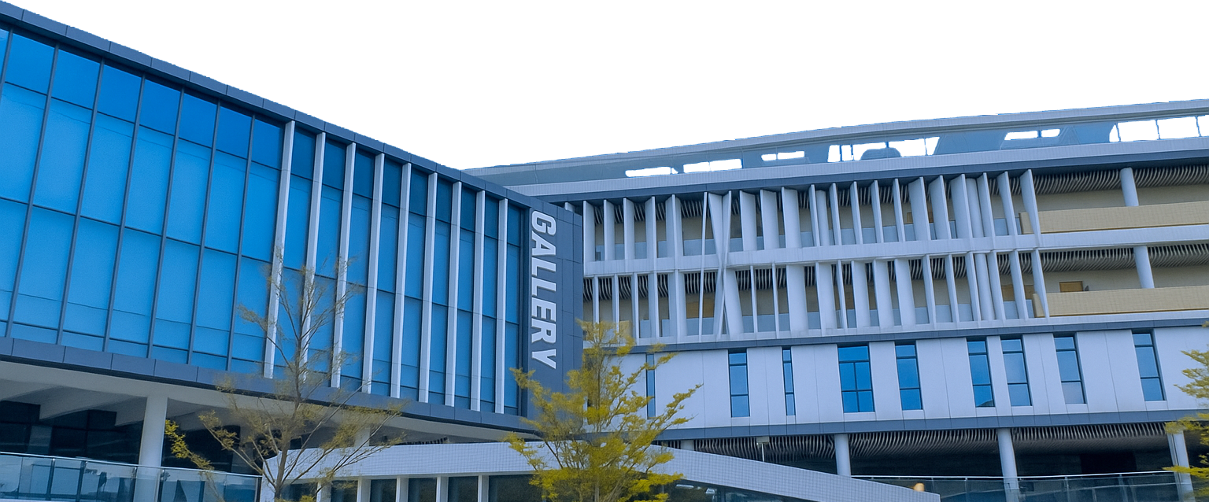
Minor Programmes
Programme Requirements
Students can claim the Minor Programme if they can fulfil the following criteria:
Complete 15 units in accordance with the stipulated Programme structure; and
Attain a minimum cumulative GPA of 2.0 for all the 5 courses (i.e. 2 compulsory courses and 3 elective courses).
SCHOOL OF CULTURE AND CREATIVITY
文化与创意学院
2026 Minor Programme Information Talk
By Prof. Matthew SANSOM
Associate Dean of SCC

Slide 2
Minor Programmes Briefing 2026
There are FOUR Minor Programmes within SCC:
Minor Programme in Arts and Design (AD) targeting non-MAD students
艺术与设计副修
Minor Programme in Theatre and Performance (TP) targeting non-CTV students
剧场与表演副修
Minor Programme in Tourism and Event Management (TEM) targeting non-CCM/THEM students
旅游和活动管理副修
Minor Programme in Music (MUS) targeting non-MUS students
音乐副修

Slide 3

Minor in Arts and Design
Who will be interested?
Those talented individuals with passion and initiative who would like to enhance their skills in acting, directing, designing, writing and producing a variety of projects in live and mediated performance projects. The Programme provides opportunities for students to pursue their interest in commercial driven, fine art driven, and social engagement forms of performance.
What to complete?
TWO required courses:
THREE elective courses out of the following 9 (at least ONE course should be at level-3 or above):
Code | English Title | Chinese Title | Units | Level
MAD2003 | Design Fundamentals | 设计基础 | 3 | 2
MAD2033 | History of Media Arts and Design | 媒体艺术与设计史 | 3 | 2
Code | English Title | Chinese Title | Units | Level
MAD1003 | Studio Art Practices: Drawing Fundamentals | 工作室艺术实践：素描基础 | 3 | 1
MAD2013 | Art Media Fundamentals | 艺术媒材基础 | 3 | 2
MAD2023 | Appreciation of the Arts | 当代艺术赏析 | 3 | 2
MAD2043 | Concept Development for Time-based Media | 时基媒体概念发展 | 3 | 2
MAD3003 | Photography | 摄影学 | 3 | 3
MAD3023 | Digital Imaging and Design | 数字图像与设计 | 3 | 3
MAD3053 | Colour Concepts, Theory and Planning | 色彩观念、理论与策划 | 3 | 3
MAD3073 | Language for Audio-visual Design | 音影设计语言 | 3 | 3
MAD4013 | Studio Art Practices: Experimental Media | 工作室艺术实践：实验媒体 | 3 | 4

Slide 4
Minor in Theatre and Performance
Who will be interested?
Those talented individuals with passion and initiative who would like to enhance their skills in acting, directing, designing, writing and producing a variety of projects in live and mediated performance projects. The Programme provides opportunities for students to pursue their interest in commercial-driven, fine art-driven, and social engagement forms of performance.
What to complete?
TWO required courses:
THREE elective courses out of the following 10 (at least ONE course should be at level-3 or above):
Code | English Title | Chinese Title | Units | Level
CTV2083 | Fundamentals of Acting | 影视戏剧表演基础 | 3 | 2
TAP2003 | Survey to Theatre and Performance | 剧场与表演纵览 | 3 | 2
Code | English Title | Chinese Title | Units | Level
TAP1003 | Classic Dramatic Literature | 经典戏剧文学 | 3 | 1
TAP2013 | Aesthetics of Theatre and Performance | 剧场与表演美学 | 3 | 2
TAP2023 | Performance Design: Set, Light, Sound | 表演设计：布景、灯光、音效 | 3 | 2
TAP2033 | Performance Design: Costume and Props | 表演设计：服装和道具 | 3 | 2
TAP3003 | Advanced Acting Training | 高级表演课 | 3 | 3
TAP3013 | Directing and Producing: Advance Theatre Making | 导演与制作：高级剧场策划 | 3 | 3
TAP3023 | Playwrighting and Dramaturgy | 编剧与表演 | 3 | 3
TAP3033 | Site-specific Theatre and Performance | 基于特定空间的戏剧与表演 | 3 | 3
TAP4003 | Post-dramatic Theatre and Digital Performance Making | 后戏剧剧场与数字化表演 | 3 | 4
TAP4013 | Composition Practicum and Final Projects | 综合实习与毕业作品 | 3 | 4

Slide 5
Minor in Tourism and Event Management
Who will be interested?
Those who would like to pursue their interest in tourism and event industry and to apply the knowledge in the major fields of studies and personal lives.
What to complete?
TWO required courses:
THREE elective courses out of the following 8 (at least ONE course should be at level-3 or above):
Code | English Title | Chinese Title | Units | Level
CCM2113 | Event Planning and Management | 节庆活动策划与管理 | 3 | 2
TEM2003 | Introduction to Hospitality and Tourism | 款待与旅游导论 | 3 | 2
Code | English Title | Chinese Title | Units | Level
CCM3093 | Basic Studies of Cultural Tourism in China | 中国文化旅游基础 | 3 | 3
CCM3133 | Exhibition Design: Creative Interpretation and Management | 展览设计：创意演绎及管理 | 3 | 3
CCM4053 | Cultural Heritage and Tourism | 文化遗产及旅游业 | 3 | 4
TEM3003 | Leisure and Society | 休闲与社会 | 3 | 3
TEM3013 | Introduction to Entertainment Business | 娱乐产业导论 | 3 | 3
TEM3023 | Club Management | 俱乐部管理 | 3 | 3
TEM3033 | Resort Management | 度假村管理 | 3 | 3
TEM4013 | Sustainable Tourism | 旅游与可持续性发展 | 3 | 4

Slide 6
Minor in Music
Who will be interested?
Those students who are passionate in acting, directing, design, writing, and production in Music. The programme training combines studio practice with critical theory, preparing them to integrate artistic creativity with academic studies.
What to complete?
TWO required courses:
Code | English Title | Chinese Title | Units | Level
MUS1093 | Music Theory | 音乐理论 | 3 | 1
MUS1083 | Choral Studies, or | 合唱研究，或 | 3 | 1
MUS1103 | Orchestral Studies, or | 管弦乐队研究，或
MUS1123 | Chamber Music Studies | 室内乐研究

Slide 7
Minor in Music
THREE elective courses out of the following 16 (at least ONE course should be at level-3 or above):
Code | English Title | Chinese Title | Units | Level
MUS1043 | Music History: Film Music | 音乐史：电影音乐 | 3 | 1
MUS1113 | Introduction to World Music | 世界音乐导论 | 3 | 1
MUS1153 | The Art and Craft of Songwriting | 作曲艺术 | 3 | 1
MUS2003 | Compositional Techniques | 作曲法 | 3 | 2
MUS2013 | History of Western Classical Music (1600 to 1800) | 西方古典音乐史（1600-1800） | 3 | 2
MUS2023 | History of Western Classical Music (1800 to 1945) | 西方古典音乐史（1800-1945） | 3 | 2
MUS2033 | Aural Training | 视唱练耳 | 3 | 2
MUS2183 | Keyboard Performance Studies I | 键盘演奏法 I | 3 | 2
MUS2193 | Keyboard Performance Studies II | 键盘演奏法 II | 3 | 2
MUS2203 | Ensemble Studies | 重奏研究 | 3 | 2
MUS2213 | Technology of Music and Sound for Screen | 影片音乐与音效技术 | 3 | 2
MUS2223 | History of Western Classical Music: The American Musical | 西方古典音乐史：美国音乐剧 | 3 | 2
MUS2433 | Introduction to Musical Theatre | 音乐剧入门 | 3 | 2
MUS3003 | Music Since 1945 | 现代音乐（1945—） | 3 | 3
MUS3013 | Creative Music Technology | 创意音乐科技 | 3 | 3
MUS3023 | Tonal Counterpoint | 调性对位法 | 3 | 3

Slide 8
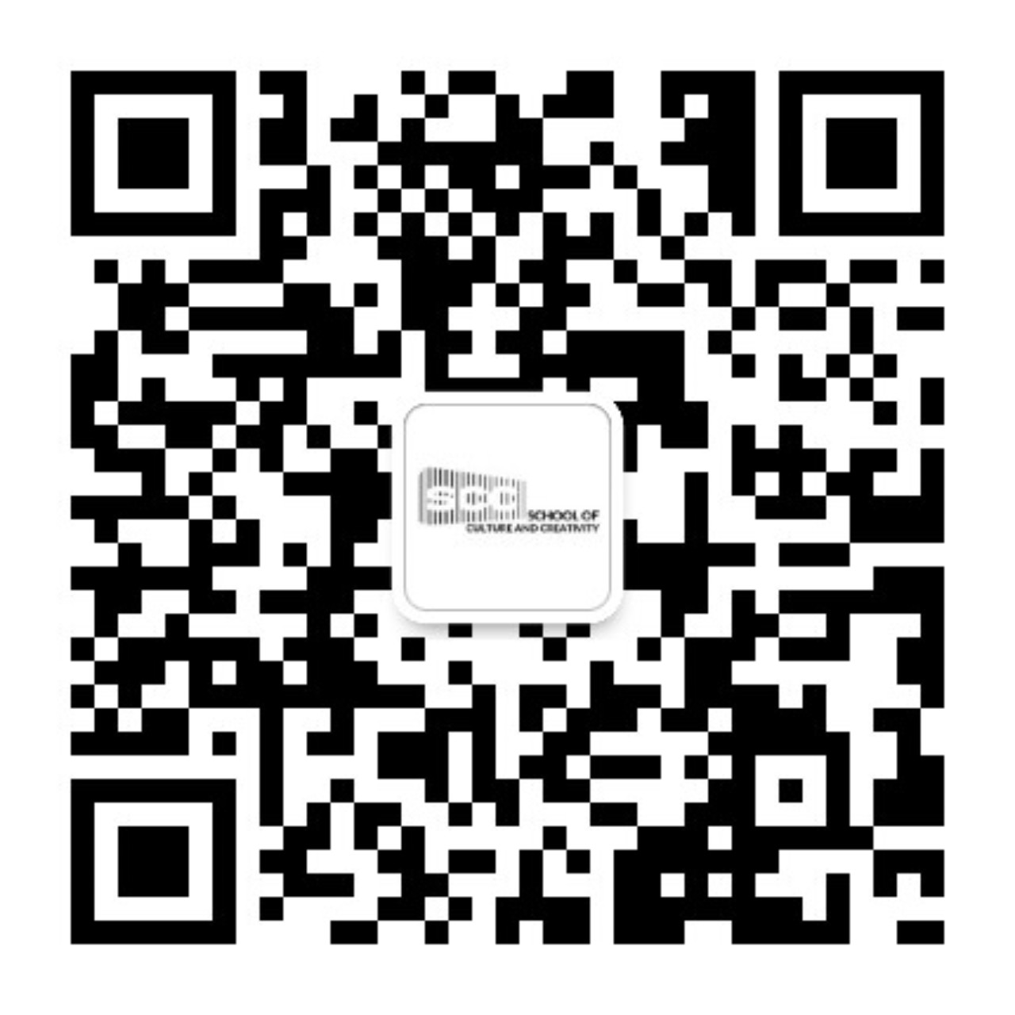
Minor Programmes
THANK YOU!
Programme Requirements
Students can claim the Minor Programme if they can fulfil the following criteria:
Complete 15 units in accordance with the stipulated Programme structure; and
Attain a minimum cumulative GPA of 2.0 for all the 5 courses (i.e. 2 compulsory courses and 3 elective courses).
Follow us for more information

